Slide 1
CENG 538
Advanced Graphics and UIs
Ray Tracing (1)

Slide 2
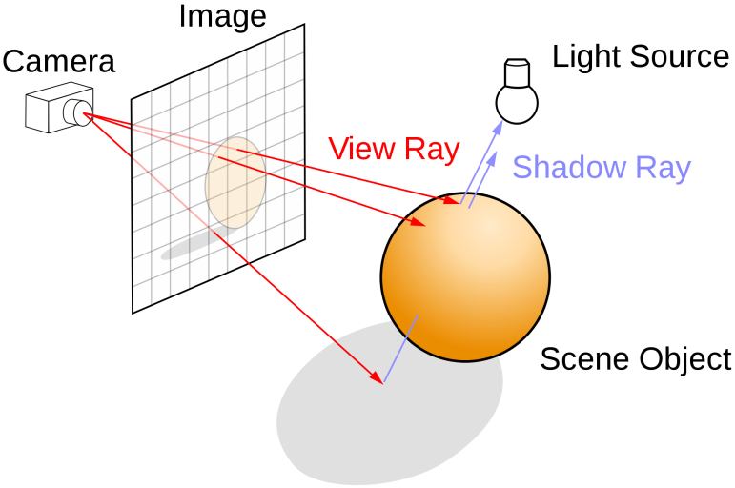
Ray Tracing
In ray tracing, we model the propagation of light and its interaction with materials to create realistic images
Different from reality, we assume that the rays originate from the eye (or the camera)
This allows us to avoid processing rays that will not be visible to the eye (or the camera)
wikipedia.com

Slide 3
Components
In RT, we have the following components:
  Camera (or eye)
  Image plane
  Objects
  Light sources
  and lots of rays!

Slide 4
Camera
Camera represents the origin of the rays that we will trace
It is represented by a position (e) and orientation (u, v, w)
These vectors are orthogonal to each other
v
The position and the orientation are defined with respect to a global (or world) coordinate system
This global system has origin at (0, 0, 0) and its three axis are: (1, 0, 0), (0, 1, 0), (0, 0, 1)
e
w
u

Slide 5
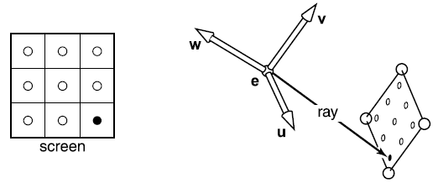
Camera
The u, v, w vectors of the camera have the following meaning:
  v: up vector
  w: opposite of gaze vector
  u: v x w with x representing cross-product
v
e
w
u

Slide 6
Image Plane
Image plane is a surface on which the final image is formed
It is divided into pixels through which rays will be cast
It is represented by its:
  Resolution (nx, ny)
  Distance to the camera
  Left, right, top, bottom coordinates
(0, 0)
t
l
The image plane is typically centered and orthogonal with respect to the camera
r
v
b
e
distance
w
u
(n_{x} - 1, n_{y} - 1)

Slide 7
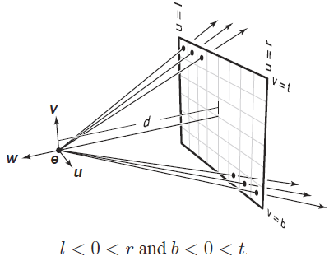
Image Plane
Image plane is a surface on which the final image is formed
It is divided into pixels through which rays will be cast
It is represented by its:
  Resolution (nx, ny)
  Distance to the camera
  Left, right, top, bottom coordinates
(0, 0)
t
l
l, r, t, b are with coordinates with respect to the camera coordinate system (not the world coordinate system)
r
v
b
e
distance
w
u
(n_{x} - 1, n_{y} - 1)

Slide 8
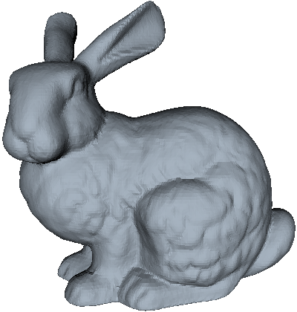

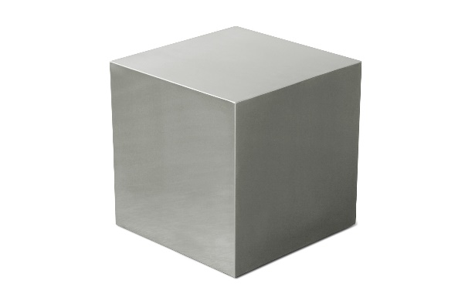
Objects
Objects consist of mathematically defined geometrical shapes or meshes made up of triangles

Slide 9
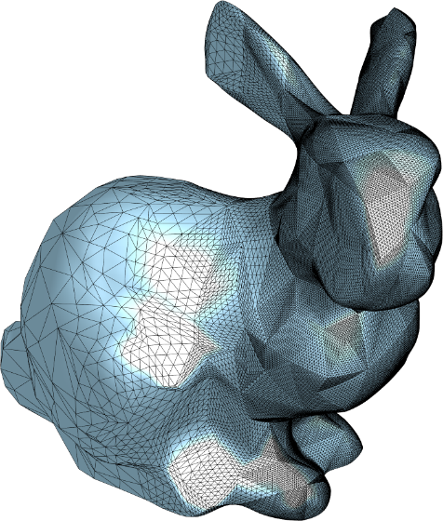
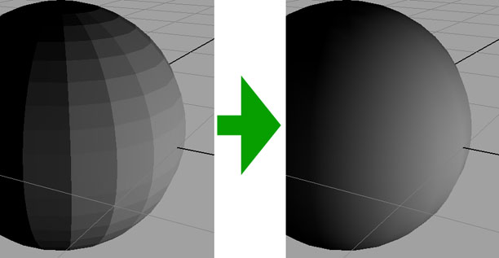
Objects
It is possible to model complex shapes using a large number of small triangles or quadrilaterals
gamedev.ru
cr4.globalspec.com/

Slide 10
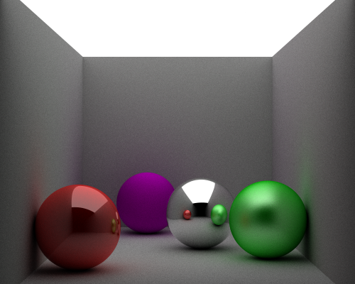
Objects
Objects may have different materials that affect their appearance
James P. O’Shea
Left to right: High-gloss, diffuse, mirrored, semi-gloss

Slide 11
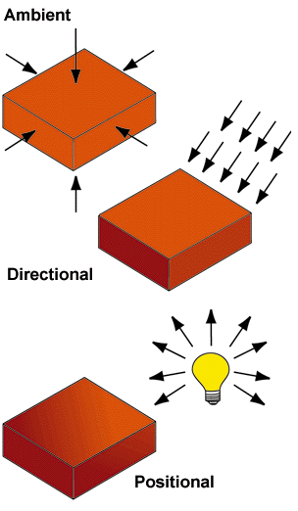
Light Sources
Light sources provide the illumination in the scene
The geometrical relationship between objects and light sources may produce shadows
Typically, three types of light sources are used:
  Ambient
  Directional
  Positional (Point)

Slide 12

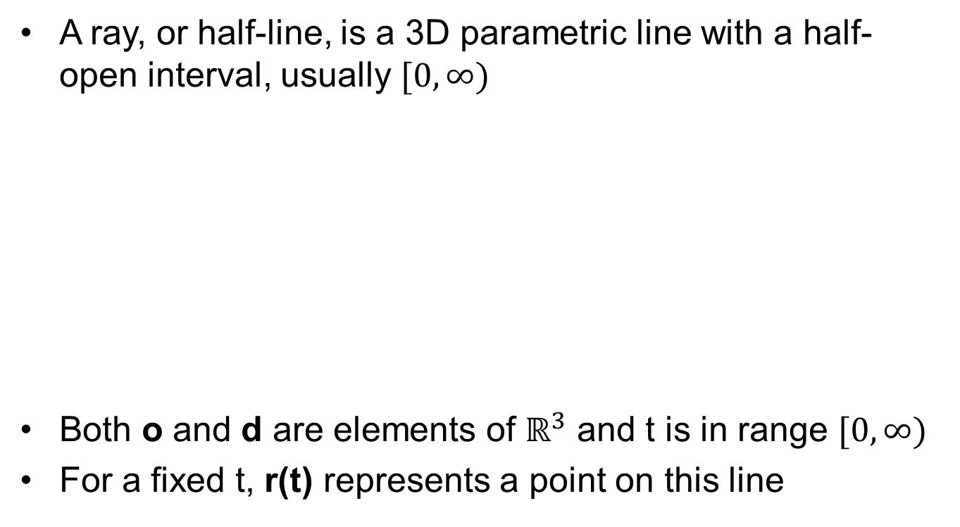
Rays
A ray, or half-line, is a 3D parametric line with a half-open interval, usually $[0,∞)$
Both o and d are elements of $ℝ^{3}$ and t is in range $[0,∞)$
For a fixed t, r(t) represents a point on this line
$$r\left(t\right)=o+td$$
origin
direction
parameter

Slide 13
Ray Tracing
The basic algorithm:
for each pixel do
compute viewing (eye, primary) rays
find first object hit by ray and its surface normal n
set pixel color to value computed from hit point, light, and n

Slide 14
Computing Eye Rays
(0, 0)
q
t
s_{u}
s_{v}
m = e + -wdistance
l
s(i,j)
s = q + s_{u}u - s_{v}v
q = m + lu + tv
m
How to find s_{u} and s_{v}?
r
s_{u} = (r – l)(i + 0.5)/n_{x}
v
b
s_{v} = (t – b)(j + 0.5)/n_{y}
e
w
u
distance
(n_{x} - 1, n_{y} - 1)
How to write the final eye ray equation?
r(t) = e + (s – e)t = e + dt
e: location of the camera
distance: camera-image plane distance
n_{x}: image width
n_{y}: image height
u, v, w: camera vectors
r, l, t, b: image plane borders (in uvw space)
What information did we use to derive this?

Slide 15
Some Example Values
u = (1, 0, 0)
v = (0, 1, 0)
e = (0, 0, 0)
n_{x} = 1024
n_{y} = 768
l = -1, r = 1
b = -1, t = 1
d = 1
Compute the ray equation passing
through the pixel (256, 192):
$$r\left(t\right)= \left[\begin{matrix}0 \\ 0 \\ 0\end{matrix}\right]+t\left[\begin{matrix}−0.5+1/1024 \\ 0.5−1/768 \\ −1\end{matrix}\right]$$
Where is this ray at t = 0, t = 1, t = 2?

Slide 16
Ray-Object Intersections
Goal: To decide at what point, if any, a 3D line (ray) intersects a 3D surface

Slide 17
Parametric Lines
A 2D line can be represented as: y – mx – b = 0. This is called the implicit form
A parametric 2D line can be represented as:
A 3D parametric line (ray) can be written as:
Alternatively, in vector form, we can write r(t) = o + td where o = (2, 1, 3) and d = (7, 2, -5)
x(t) = 2 + 7t
y(t) = 1 + 2t
x(t) = 2 + 7t
y(t) = 1 + 2t
z(t) = 3 – 5t

Slide 18
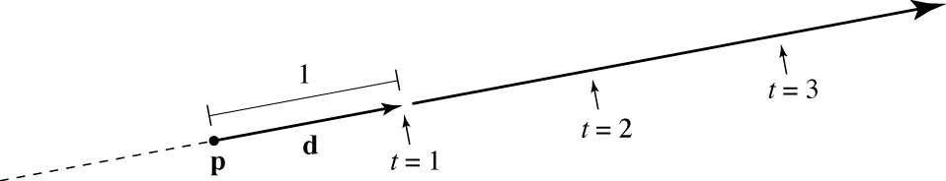
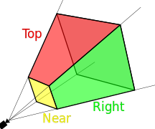
Ray (Reminder)
A ray is a half-line represented by r(t) = o + td with t ≥ 0.
We want to know if a ray intersects an object with t in the interval [t_{min}, t_{max}]
  If t < t_{min}, the object is too close (maybe in front of the image plane).
  If t > t_{max}, the object is too far (outside the range we want to consider).

Slide 19
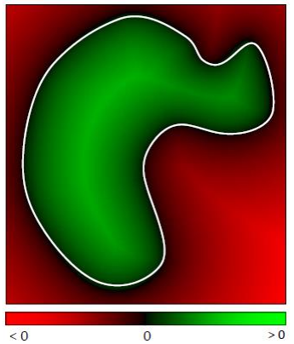
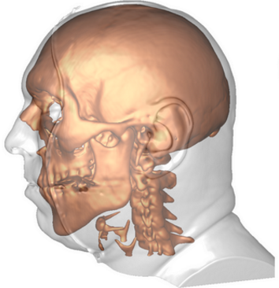
Implicit Surfaces
Rays will intersect surfaces, so we need to know how to represent surfaces
In implicit form a surface can be written as f(x, y, z) = 0
Why is it called implicit?
  You can test whether a point is on the surface, but you cannot generate points on the surface
Another way to write: f(p) = 0 where p = (x, y, z)
A ray will intersect this surface if:
f(r(t)) = f(o + td) = 0

Slide 20
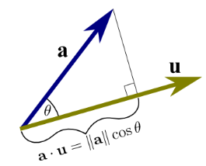
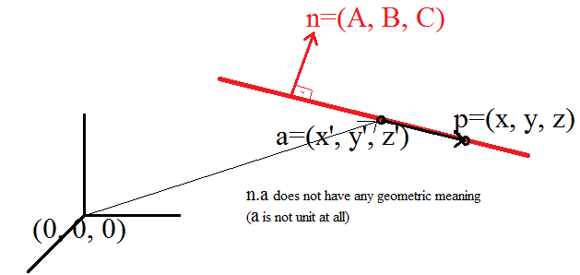
Ray-Plane Intersection
Consider the plane equation written in vector form as:
Here, a is a point on the plane, n is the normal vector of the plane
a and n, are known quantities and p is the variable.
(p – a).n = 0
If you expand this, you get the familiar Ax + By + Cz + D = 0 equation
n.(p-a)=0 →n.p – n.a = 0 →Ax+By+Cz – Ax’-By’-Cz’=0
// n.a = -D
a
n

Slide 21

Ray-Plane Intersection
Simply plug r(t) = o + td into the previous equation:
Solving for t, we get:
If t is in [tmin, tmax], the ray hits the plane and it is within the limits of our desired viewing range
What if d.n = 0?
(o + td – a).n = 0
Using identities (wikipedia):
t = (a – o).n / (d.n)

Slide 22
Ray-Sphere Intersection
A sphere can be represented as:
where c = (c_{x}, c_{y}, c_{z}) is the center and R is the radius
In vector form, we can rewrite this as:
Again, plug in the ray equation to find t:
(x – c_{x})² + (y – c_{y})² + (z – c_{z})² – R² = 0
(p – c).(p – c) – R² = 0
(o + td – c).(o + td – c) – R² = 0

Slide 23

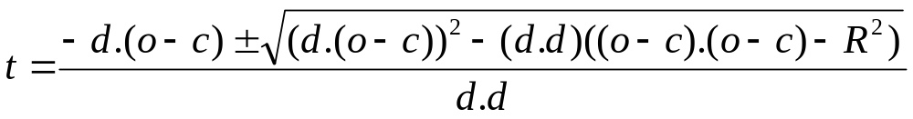
Ray-Sphere Intersection
This gives:
Note that, this is a quadratic equation in t:
The solution is:
What if the discriminant D is less than zero?
  Bounding sphere trick
(d.d)t² + 2d.(o – c)t + (o – c).(o – c) – R² = 0
At² + Bt + C = 0
t₂
t₁

Slide 24
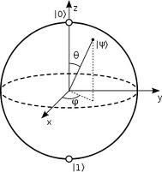
Ray-Triangle Intersection
So far, we have been using implicit equations to represent surfaces: f(x, y, z) = 0
Ray-triangle intersection is best found if the triangle is represented using a parametric form:
For instance, a sphere in parametric form can be represented as:
x = f(u, v)
y = g(u, v)
z = h(u, v)
x = r cosΦ sinΘ
y = r sinΦ sinΘ
z = r cosΘ

Slide 25
Ray-Triangle Intersection
Two techniques are possible:
  Based on implicit form (ray-plane intersection followed by angleSum or sameSide tests)
  Based on parametric (barycentric) coordinates

Slide 26


Implicit Method
First, intersect the ray with the plane of the triangle:
  The plane normal can be found by cross product
  The plane equation can be found from the normal and a point
  Slide 21
a
n
$$n=\left(c −b\right) x (a −b)$$
$$f\left(p\right)=\left(p−a\right).n=0$$
c
b

Slide 27
Implicit Method
If the ray intersects triangle’s plane, we need to determine if it is inside the triangle
  We can resort to angle sums
a
p
c
b

Slide 28
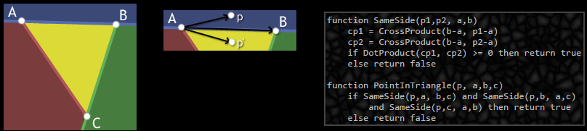
Implicit Method
If the ray intersects triangle’s plane, we need to determine if it is inside the triangle
  We can resort to cross and dot products
  (B-A) x (p-A) points out of the screen (for any p above AB)
  (B-A) x (p’-A) points into the screen (for any p’ below AB)
  What direction should x point in?
    Take reference point C which is on a certain side of AB
    Any point p where (B-A)x(p-A) not point in the same direction as (B-A)x(C-A) not in triangle

Slide 29
Parametric Method
A triangle is best parameterized using barycentric coordinates:
What does it mean if α = 0 or β = 0 or γ = 0?
What if both α = 0 and β = 0?
p(α, β, γ) = αa + βb + γc
with the constraints
0 < α < 1
0 < β < 1
0 < γ < 1
and
α + β + γ = 1
c
α = A_{a} / A
β = A_{b} / A
γ = A_{c} / A
A_{b}
A_{a}
A_{c}
a
b

Slide 30
Parametric Method
Note that we can eliminate one of the parameters:
Then the point p is inside the triangle if and only if:
The ray r(t) = o + td hits this plane where:
α = 1 – β – γ
p(β, γ) = a + β(b – a) + γ(c – a)
β + γ < 1
0 < β
0 < γ
o + td = a + β(b – a) + γ(c – a)

Slide 31
Parametric Method
How to solve for t?
Expand from the vector form into individual coordinates:
The unknowns here are t, β, and γ.
We have 3 equations and 3 unknowns.
o_{x} + td_{x} = a_{x} + β(b_{x} – a_{x}) + γ(c_{x} – a_{x})
o_{y} + td_{y} = a_{y} + β(b_{y} – a_{y}) + γ(c_{y} – a_{y})
o_{z} + td_{z} = a_{z} + β(b_{z} – a_{z}) + γ(c_{z} – a_{z})

Slide 32
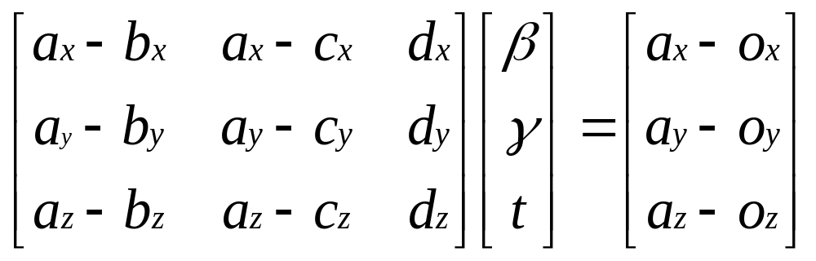
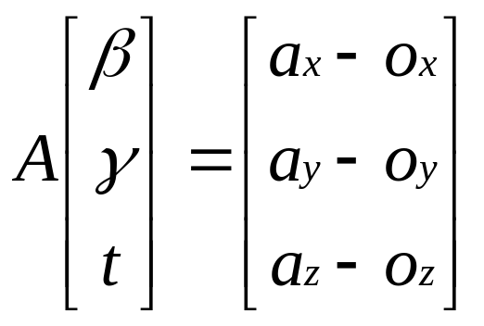
Parametric Method
Rewrite this system in matrix form:
And solve for t, β, and γ using Cramer’s rule.

Slide 33
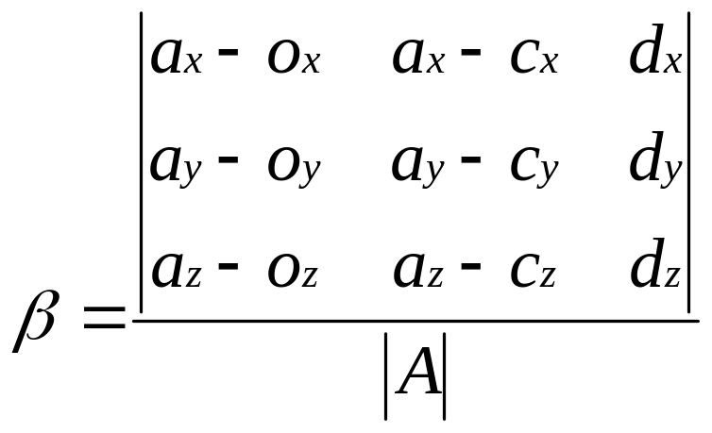
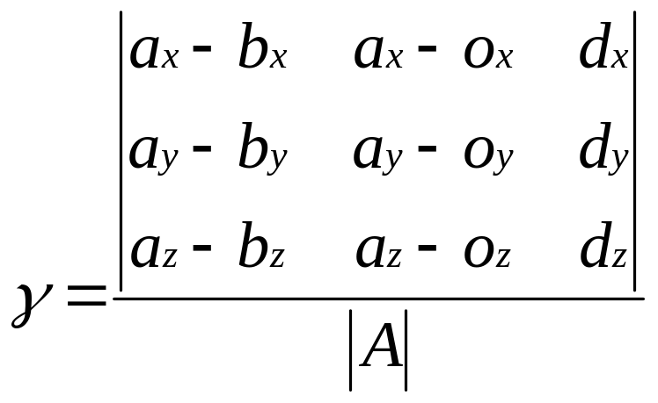
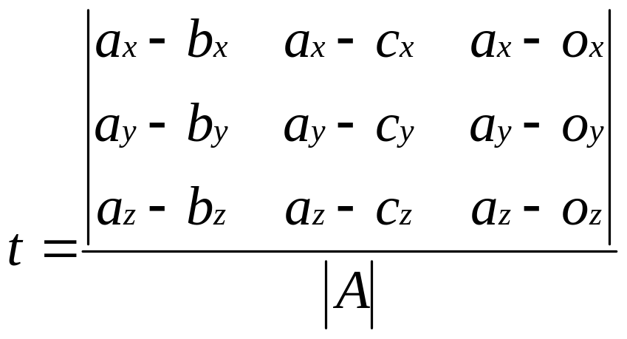
Parametric Method
Cramer’s rule:
where |.| denotes the determinant.

Slide 34
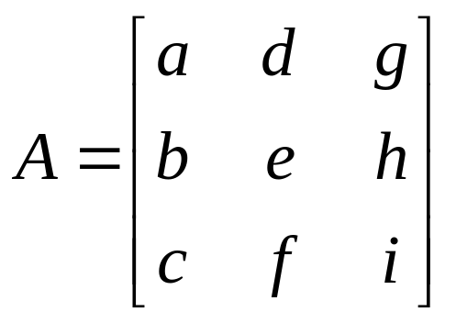
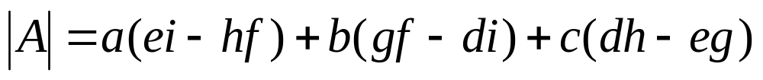
Parametric Method
If A is equal to:
Then |A| is given by:

Slide 35
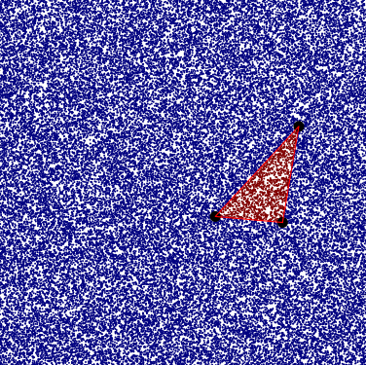
Parametric Method
Use this to find the determinants of the other terms and compute t, β, and γ.
The ray will intersect the triangle if:
Ray-triangle intersection is the most important as any complex object can be represented using a set of triangles!
tmin ≤ t ≤ tmax
β + γ < 1
0 < β
0 < γ

Slide 36
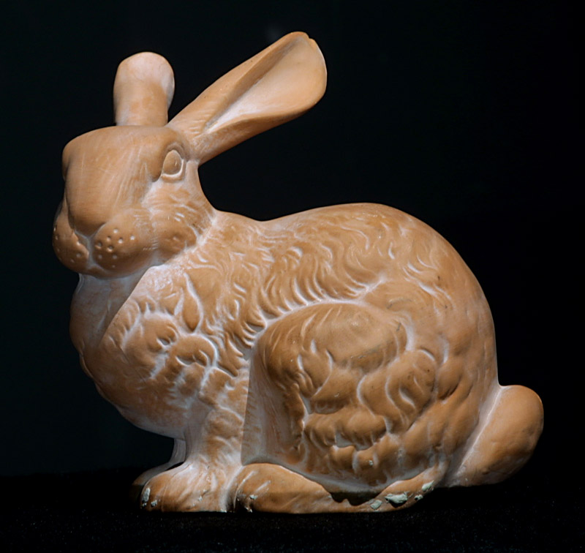
Complex Models
Bunny model composed of 725,000 triangles
From Stanford University

Slide 37
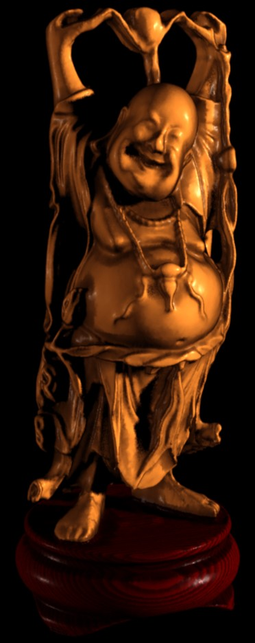
Complex Models
Buddha model composed of 9,200,000 triangles
From Stanford University

Slide 38
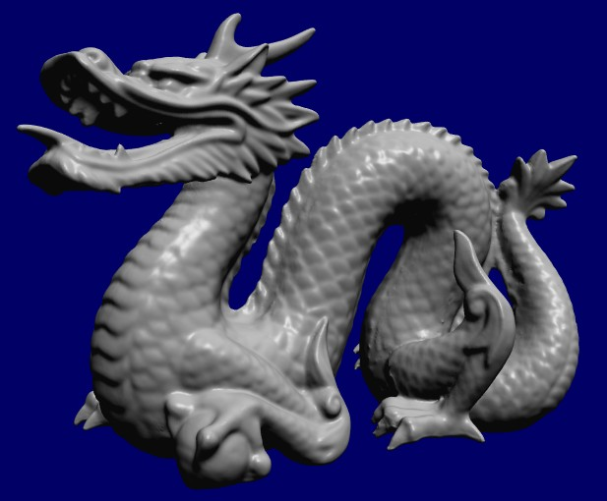
Complex Models
Dragon model composed of 5,500,000 triangles
From Stanford University

Slide 39
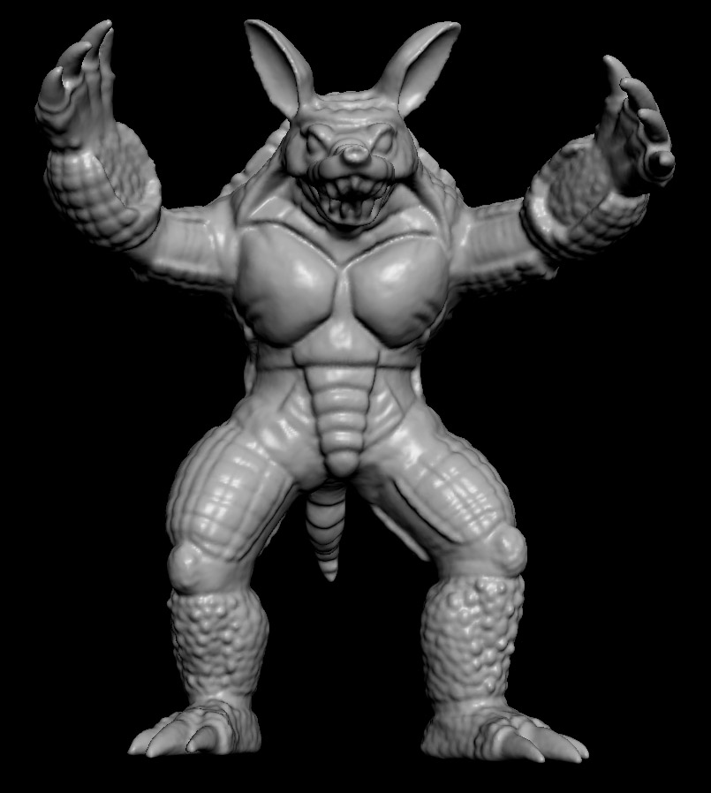
Complex Models
Armadillo model composed of 7,500,000 triangles
From Stanford University

Slide 40
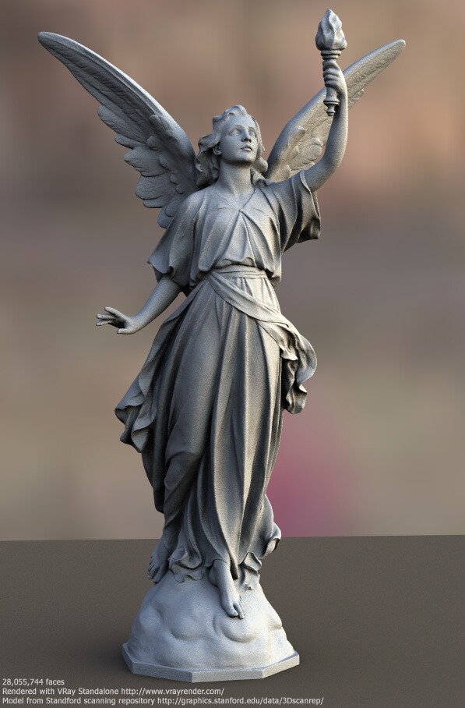
Complex Models
Lucy model composed of 116,000,000 triangles
From Stanford University

Slide 41
Complex Models
Let’s compute how many intersection tests we need to perform to render a model composed of 1,000,000 triangles with an image size of 1024x768.
1,000,000 * 1024 * 1024 ≈ 1,000,000,000,000 (one trillion)
That’s why ray tracing is generally slow.
Luckily, the number of intersection tests can be significantly reduced by using acceleration structures.

Slide 42
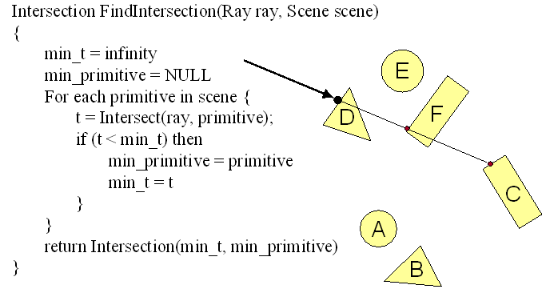
Multiple Intersections
Find intersection with front-most primitive in scene

Slide 43
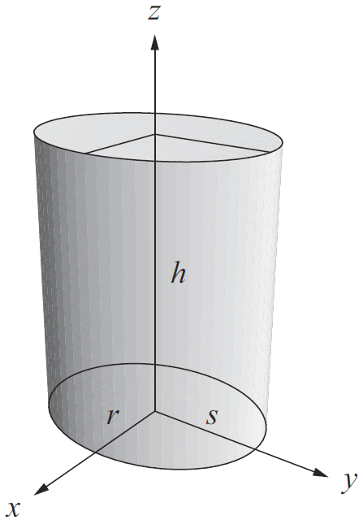
Ray-Cylinder Intersection
More intersections with mathematically defined objects
Recall our ray is r(t) = o + td
Elliptical cylinder whose base is centered on x-y plane origin
  x² + m²y² = r²
  0 ≤ z ≤ h
  m = r/s (circular iff r=s)

Slide 44
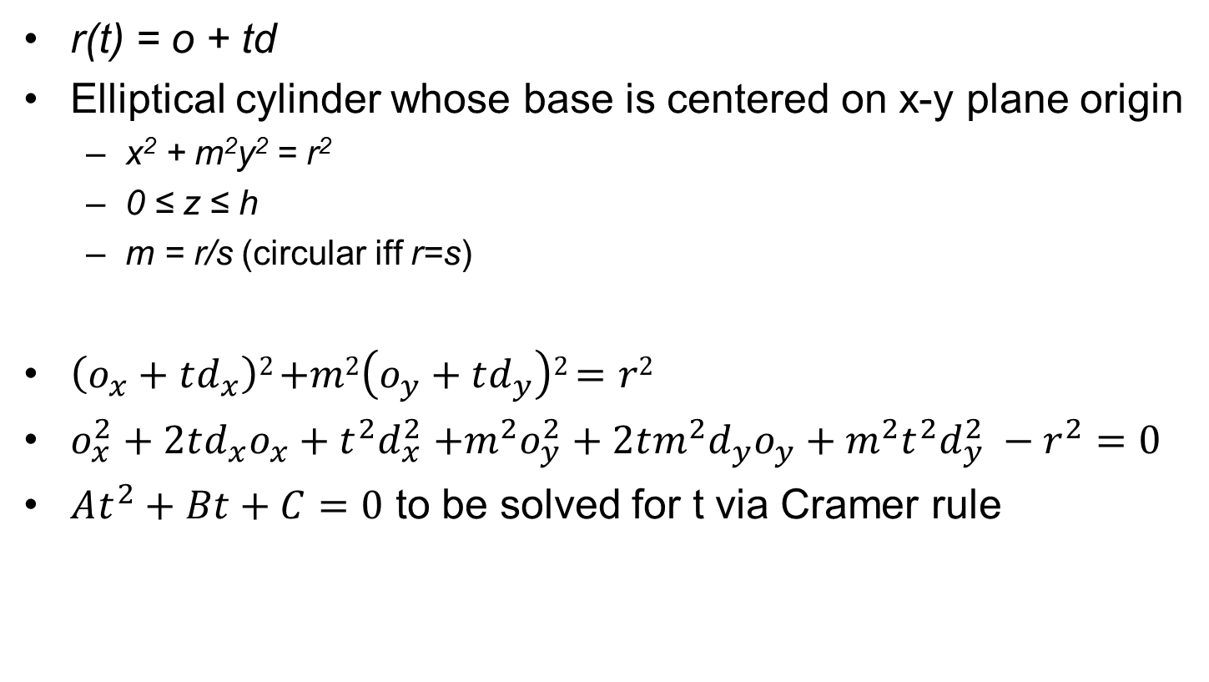
Ray-Cylinder Intersection
r(t) = o + td
Elliptical cylinder whose base is centered on x-y plane origin
  x² + m²y² = r²
  0 ≤ z ≤ h
  m = r/s (circular iff r=s)
$\left(o_{x}+td_{x}\right)2$ $+m2\left(o_{y}+td_{y}\right)2$ $=r2$
$o_{x}^{2}+2td_{x}o_{x}+t^{2}d_{x}^{2}$ $+m^{2}o_{y}^{2}+2tm^{2}d_{y}o_{y}+m^{2}t^{2}d_{y}^{2} −r^{2}=0$
$At^{2}+Bt+C=0$ to be solved for t via Cramer rule

Slide 45
Ray-Box Intersection
A box is described by 6 plane equations
  x = 0
  x = r_{x}
  y = 0
  y = r_{y}
  z = 0
  z = r_{z}
Our ray is described by r(t) = o + td
Idea: A ray intersecting one of these planes (x = r_{x}) must not go out of bounds in the other dimensions (0, r_{y}, r_{z})

Slide 46
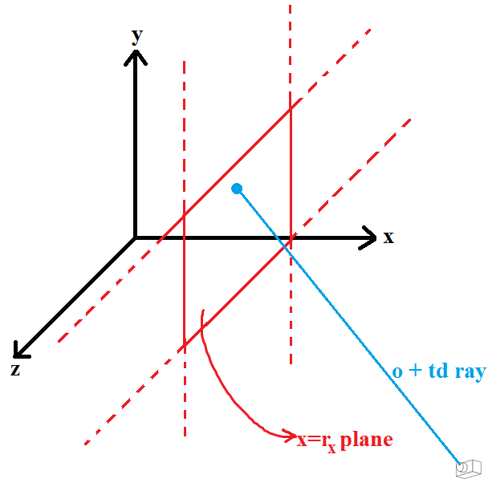
Ray-Box Intersection
Ray intersects x = r_{x} plane at t = (r_{x} - o_{x}) / d_{x}
Check if this t stays in-bounds for the other dimensions:
  0 ≤ r(t).y ≤ r_{y}
  0 ≤ r(t).z ≤ r_{z}

Slide 47
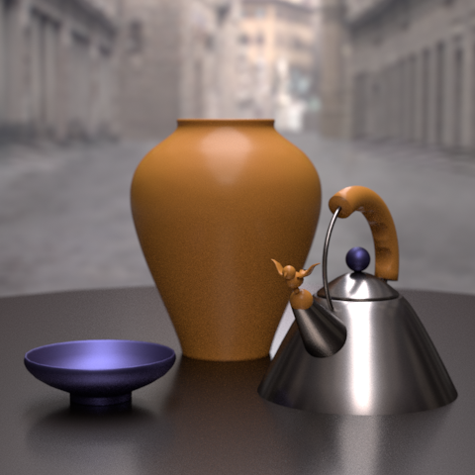
Realism
Intersection tests give us the surface position that is hit by a ray.
To create realistic images, we need to compute realistic models of light-surface interaction at that point on the surface.
This will be the topic of the next lecture.
From ACM Siggraph

Slide 48
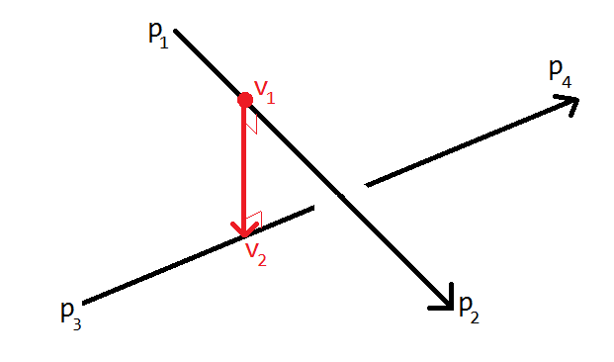
More on x- and dot-products
Before the realistic color models, let’s see more applications of cross-product and dot-product.
Question: Distance between 2 lines in 3D?

Slide 49


More on x- and dot-products
Distance between 2 lines in 3D?
a=(p₂ – p₁) and x=(v₂ – v₁) must be perpendicular: a.x = 0
b=(p₄ – p₃) and x=(v₂ – v₁) must be perpendicular: b.x = 0
a₀x₀ + a₁x₁ + a₂x₂ = 0
b₀x₀ + b₁x₁ + b₂x₂ = 0
➔ 2 equations 3 unknowns ☹

Slide 50
More on x- and dot-products
Distance between 2 lines in 3D?
Replace v₁ with p₁ + t(p₂ - p₁); similarly v₂ = p₃ + s(p₄ - p₃)
2 eqs 2 unknowns; solve for t and s
Find v₁ using t and v₂ using s
Answer = ||v₂ - v₁||

Slide 51
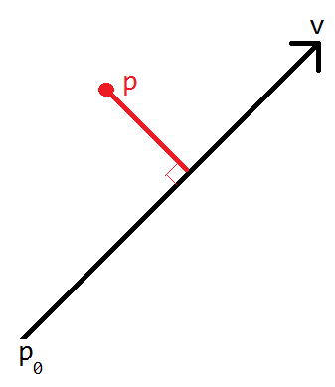
More on x- and dot-products
Distance between a point and a line?
a = point where red-black intersects
(p-a).v = 0
1 equation 3 unknowns (a_{x}, a_{y}, a_{z}) ☹

Slide 52
More on x- and dot-products
Distance between a point and a line?
a = point where red-black intersects
(p-a).v = 0
Replace a with p₀ + tv
(p - p₀ - tv).v = 0
At² + Bt + C = 0 situation gives t
t gives a and answer = ||p-a||

Slide 53
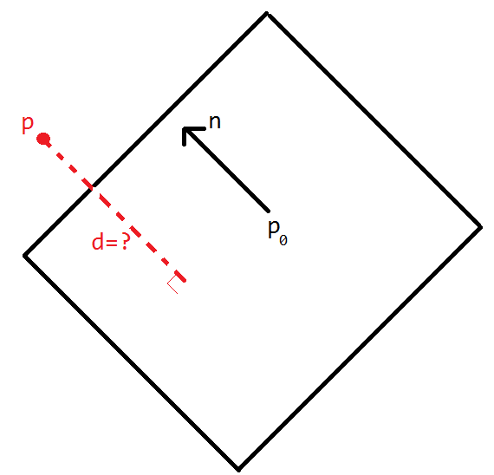
More on x- and dot-products
Distance between a point and a plane?

Slide 54
More on x- and dot-products
Distance between a point and a plane?
d = (p-p₀).n where ||n||=1
d = ((p-p₀).n) / ||n|| in general

Slide 55
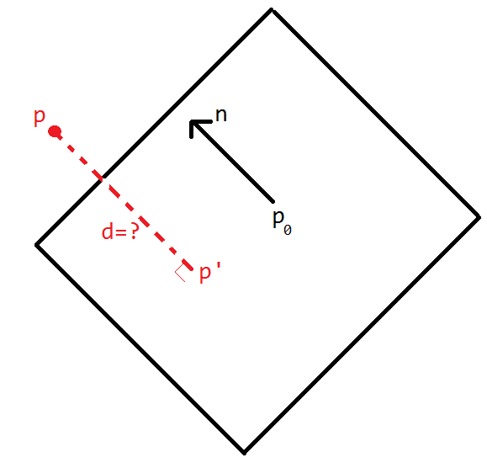
More on x- and dot-products
Distance between a point and a plane?
Alternative solution:
(p’ – p₀).n = 0 //p’ = p.projection
(p + tn - p₀).n = 0
(p - p₀).n + tn.n = 0
t = (p₀ - p).n / ||n||²
d = ||p – p’|| = ||p – p – tn|| = -t||n||
d = -(p₀ - p).n / ||n||² * ||n|| = ((p - p₀).n) / ||n||

